Slide 1
Quiz
What is a SYSTEM CALL and how it is executed?
Answer p.g. 23

Slide 2

Operating Systems How not to go bananas?! your first bootloader
Omar Shaaban
Minia Uni. – Faculty of Engineering
Computer and Systems dept.
17 - March – 2016

Slide 3
Recap

Slide 4
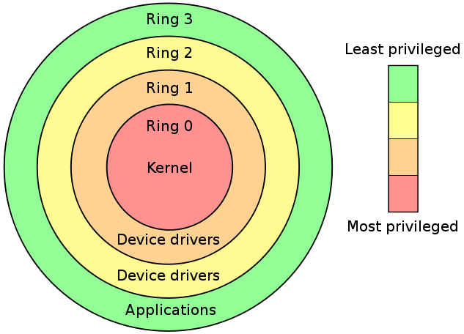
Protection Rings
Notes:
Computer operating systems provide different levels of access to resources.
A protection ring is one of two or more hierarchical levels or layers of privilege within the architecture of a computer system. In any modern operating system, the CPU is actually spending time in two very distinct modes:
1.Kernel Mode
In Kernel mode, the executing code has complete and unrestricted access to the underlying hardware. It can execute any CPU instruction and reference any memory address. Kernel mode is generally reserved for the lowest-level, most trusted functions of the operating system. Crashes in kernel mode are catastrophic; they will halt the entire PC.
2. User Mode
In User mode, the executing code has no ability to directly access hardware or reference memory. Code running in user mode must delegate to system APIs to access hardware or memory. Due to the protection afforded by this sort of isolation, crashes in user mode are always recoverable. Most of the code running on your computer will execute in user mode.

Slide 5

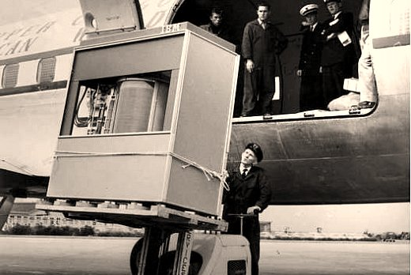
Real Mode vs. Protected Mode
Real Mode:
16-bit mode
> 1 MB memory (64K segments)
BIOS functions and interrupt
Kernel Mode (ring 0)
Exception halts the system (catastrophic)
Protected Mode
32-bit mode
4GB memory mode (descriptor selector)
User & OS Mode (ring 3)
No interrupt
System can recover from system
IBM 360 – 5 MB

Slide 6
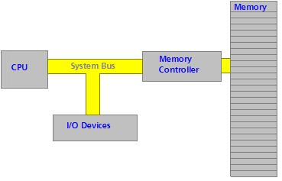
x86 Architecture
Notes:
here are a couple of important things to note. As you know, the CPU fetches data and instructions from memory. The Memory Controller is responsible for calculating the exact RAM chip and memory cell that it resides in. Because of this, The CPU communicates with the Memory Controller.
Also, notice the "I/O Devices". They are connected to the system bus. All I/O Ports are mapped to a given memory location. This allows us to use the IN and OUT instructions.
Controllers:
A Controller provides basic hardware control functionality. It also provides the basic interface between hardware and software. This is important to us. Remember that in protected mode, we will not have *any* interrupts available to us. In the bootloader, we used several interrupts to communicate with the hardware. Using these interrupts in protected mode will cause a Triple Fault.
Software Ports
THIS will be very important to us. This is our interface to the hardware. A Software Port is a number. Thats it. This number represents a hardware controller... Kind of.

Slide 7
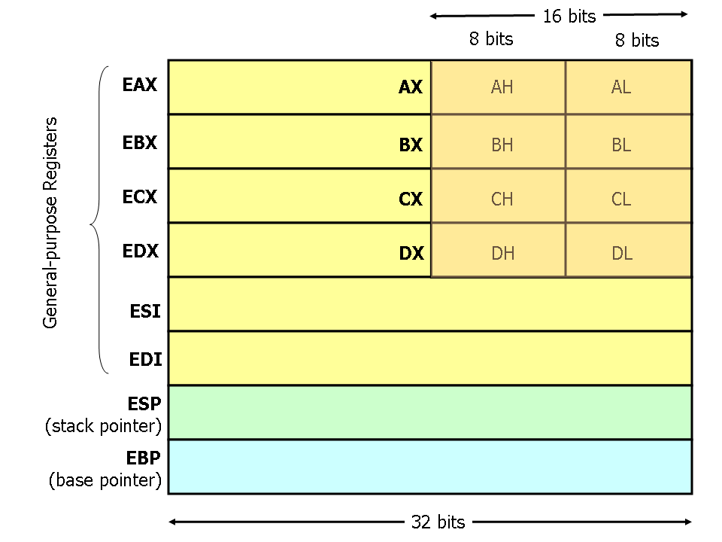
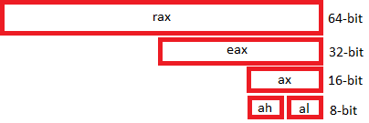
CPU Registers
Notes:
The Instruction Pointer (IP) register stores the current offset address of the currently executing instruction. Remember: This is an offset address, *Not* an absolute address! The Instruction Pointer (IP) is sometimes also called the Program Counter (PC).
On 32 bit machines, IP is 32 bits in size and uses the name EIP.
On 64 bit machines, IP is 64 bits in size, and uses the name RIP.

Slide 8
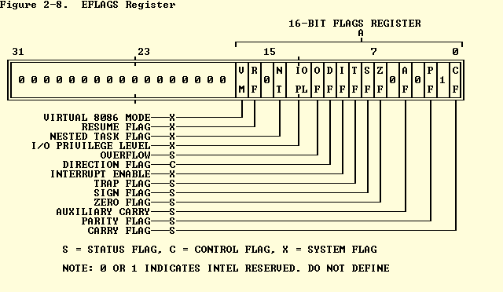

CPU Registers [cont.]
Instruction Pointer register “IP 16 bit” , “EIP 32 bit” ,and “RIP 64 bit”
Flag Register
Notes:
The Instruction Pointer (IP) register stores the current offset address of the currently executing instruction. Remember: This is an offset address, *Not* an absolute address! The Instruction Pointer (IP) is sometimes also called the Program Counter (PC).
On 32 bit machines, IP is 32 bits in size and uses the name EIP.
On 64 bit machines, IP is 64 bits in size, and uses the name RIP.

Slide 9

Assembly in a nutshell!
label: instruction operand1 , operand2 , operand3
start: add al , ah
inc ebx
add al , 05h
sub al , 0x05
add bx , [05h]
sub bl , [05h + 2]
sub al , [ah]
jmp start

Slide 10
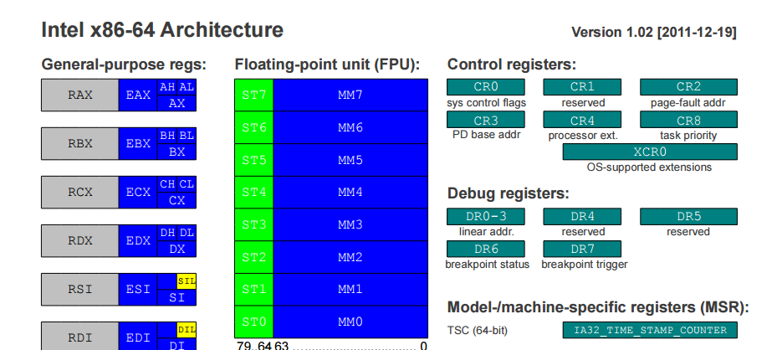
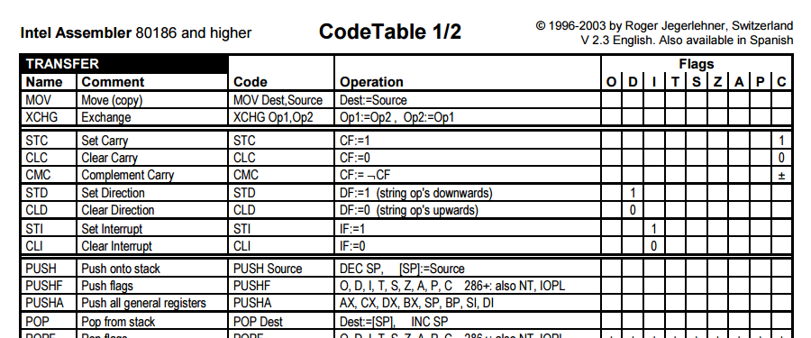
Assembly Cheat Sheets “www.cheat-sheets.org”

Slide 11
x86 Real Mode Memory Map [1MB]
0x00000000 0x00000400 0x00000500 0x00007C00 0x00007E00 0x000A0000 0x000B0000 0x000B8000 0x000C0000 0x000C8000 0x000F0000 | 0x000003FF 0x000004FF 0x00007BFF 0x00007DFF 0x0009FFFF 0x000BFFFF 0x000B7777 0x000BFFFF 0x000C7FFF 0x000EFFFF 0x000FFFFF | Real Mode Interrupt Vector Table BIOS Data Area Unused Our Bootloader Unused Video RAM (VRAM) Memory Monochrome Video Memory Color Video Memory Video ROM BIOS BIOS Shadow Area System BIOS
Notes:
Note: It is possible to remap all of the above devices to use different regions of memory. This is what the BIOS POST does to map the devices to the table above.

Slide 12
Port Mapping “IN – OUT instructions”
0x060-0x06F | Keyboard/PS2 Mouse (Port 0x60) Speaker (0x61) | Keyboard/PS2 Mouse (0x64) | System Use | System Use
WaitLoop: in al, 64h ; Get status register value]
and al, 10b ; Test bit 1 of status register
jz WaitLoop ; If status register bit not set, no data is in buffer
in al, 60h ; Its set--Get the byte from the buffer (Port 0x60), and store it
Notes:
values can be written wither 0x64 or 64h , and it stands for hexadecimal
n an IN instruction, the processor places the port address--like 0x64--into the Address Bus, and sets the I/O DEVICE line in the control bus, followed by the READ line. The device that has been assigned to 0x60 by the ROM BIOS-- In this case, the Status Register in the keyboard Controller, knows its a read operation because the READ line is set. So, it copies data from some location inside the keyboard registers onto the Data Bus, resets the READ and I/O DEVICE lines on the control bus, and sets the READY line. Now, the processor has the data from the Data Bus that was read.
An OUT instruction is simular. The processor copies the byte to be written into the Data Bus (Zero extending it to the Data Bus Width). Then, it sets the WRITE and I/O DEVICE lines on the control bus. It then copies the port address--lets say--0x60, into the Address Bus. Because the I/O DEVICE Line is set, it is a signal that tells all controllers to watch the address bus. If the number on the address bus currosponds with there assigned number, the device acts on that data. In our case--The Keyboard Controller. The Keyboard controller knows its a WRITE operation because the WRITE line is set in the control bus. So, it copies the value on the data bus into its Control Register--which was assigned port address 0x60. The Keyboard Controller the resets the WRITE and I/O DEVICE line, sets the READY line on the control bus, and the processor is back in control.
Port mapping and Port I/O are very important. It is our only way of cummunicating with hardware in protected mode. Remember: Interrupts are not avilable until we write them. To write them, along with any hardware routine--such as input and output, requires us to write drivers. All of this requires direct hardware access. If you dont feel confortable with this, practice a little first, and reread this section. If you have any questions, let me know.

Slide 13
Kernel Modules
Applications
Modules commands
lsmod
list all loaded modules
insmod
install a specific module
modprobe
loads a module and any dependancy
rmmod
remove a module
Kernel
CPU
Memory
Devices
Notes:
For a kernel to talk to external hardware it needs to have a driver will be represented by a kernel module , and it must be installed on the system to be used by the system

Slide 14
Kernel Basics
sudo apt-get update
sudo apt-get install git fakeroot build-essential ncurses-dev xz-utils libssl-dev bc
sudo apt-get install kernel-package
sudo apt-get install libqt4-dev pkg-config
sudo apt-get g++
tar xvf linux-4.5.tar.xz
cd linux-4.5
make xconfig
make-kpkg clean

Slide 15

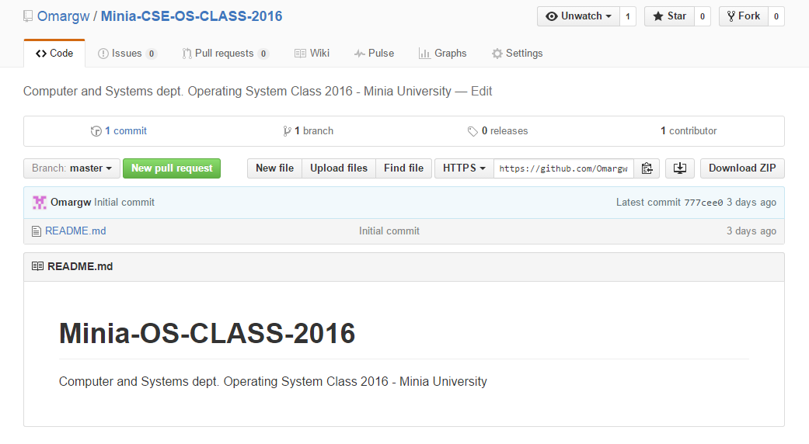
GitHub
https://github.com/Omargw/Minia-CSE-OS-CLASS-2016

Slide 16
Assignment
Write a bootloader that uses interrupts to read a character form the keyboard then displays it on the screen .
Remember that we are in 16-bit mode, interrupts are available, while in 32-bit mode they are disabled, we use Port mapping in order to access and communicate with any hardware
Soft Deadline: 24 – March – 2016 [100%]
Hard Deadline: 25 – March – 2016 [50%]

Slide 17
References
http://www.osdever.net/tutorials/view/hello-world-boot-loader
http://viralpatel.net/taj/tutorial/hello_world_bootloader.php
http://www.brokenthorn.com/Resources/OSDev4.html
http://www.codeproject.com/KB/tips/boot-loader.aspx?fid=1541607&df=90&mpp=25&noise=3&sort=Position&view=Quick&fr=1
http://www.codeproject.com/Articles/664165/Writing-a-boot-loader-in-Assembly-and-C-Part
https://www.youtube.com/channel/UCQ7UH2_NnlRTH7dQzBUqYtg
https://fawzi.wordpress.com/2009/05/24/virtualization-and-protection-rings-welcome-to-ring-1-part-i/
http://www.geek.com/chips/difference-between-real-mode-and-protected-mode-574665/
http://www.tutorialspoint.com/assembly_programming/assembly_addressing_modes.htm
https://www.youtube.com/user/dtreply
https://appusajeev.wordpress.com/2011/01/27/writing-a-16-bit-real-mode-os-nasm/
http://www.osdever.net/tutorials/view/hello-world-boot-loader
http://www.cyberciti.biz/faq/debian-ubuntu-building-installing-a-custom-linux-kernel/
http://derekmolloy.ie/writing-a-linux-kernel-module-part-1-introduction/
http://tldp.org/LDP/lkmpg/2.6/html/index.html

